Slide 1
IT 418/518: Foundations of Data Science
Class 8
Dr. Rajeev Bukralia

Slide 2
Exercise
Calculate the variance and standard deviation and a boxplot of the following sample data set using pandas:
(2, 51, 53,54, 43, 51, 62, 49, 50, 63, 60)

Slide 3
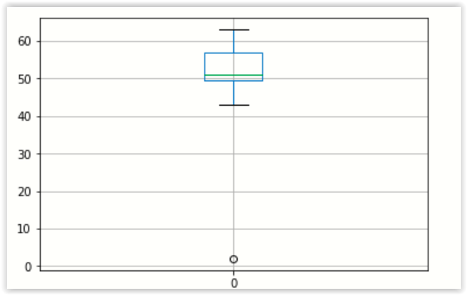
Answer
a = [2, 51, 53, 54, 43, 51, 62, 49, 50, 63, 60]
import pandas as pd
df = pd.DataFrame (a)
df
df.describe()
df.median()
df.var()
df.std()
import matplotlib.pyplot as plt
df.boxplot()
plt.show()

Slide 4
Probability Distributions
Theoretical probability distributions are useful in inferential statistics because their properties and characteristics are known.
Probability distributions are commonly classified as continuous, meaning the data can take on any value within a specified range, or discrete, meaning the data can only take on certain values.
The normal distribution as an example of a continuous distribution, and the binomial distribution as an example of a discrete distribution.

Slide 5
Normal Distribution
Most commonly used distribution in statistics.
It is a reasonable description of how many continuous variables are distributed in reality (such as test scores).
In specified conditions we may assume that sampling distributions of statistics such as the sample mean are normally distributed even if the samples are drawn from populations that are not normally distributed.
The normal distribution is also referred to as the “bell curve” due to its characteristic shape, and as the “Gaussian distribution” in honor of the18th-century physicist and mathematician Karl Gauss, who used this distribution to analyze astronomical data.

Slide 6
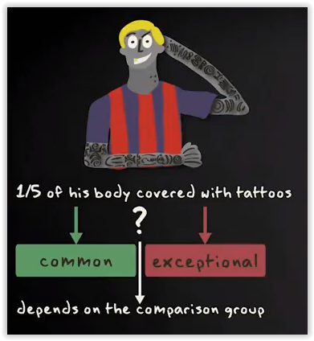

Slide 7
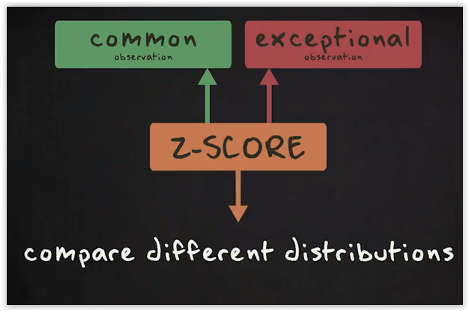
Z-Scores
Sometimes researchers want to know if a specific observation is common or exceptional. To answer that question, they express a score in terms of the number of standard deviations it is removed from the mean. This number is what we call a z-score.
A z-score gives you information about how extreme an observation is. Z-scores are even more useful if you want to compare different distributions.

Slide 8
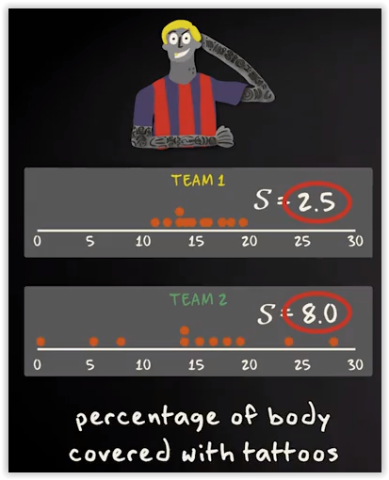
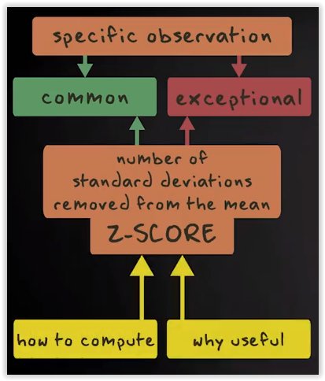
Z-scores

Slide 9
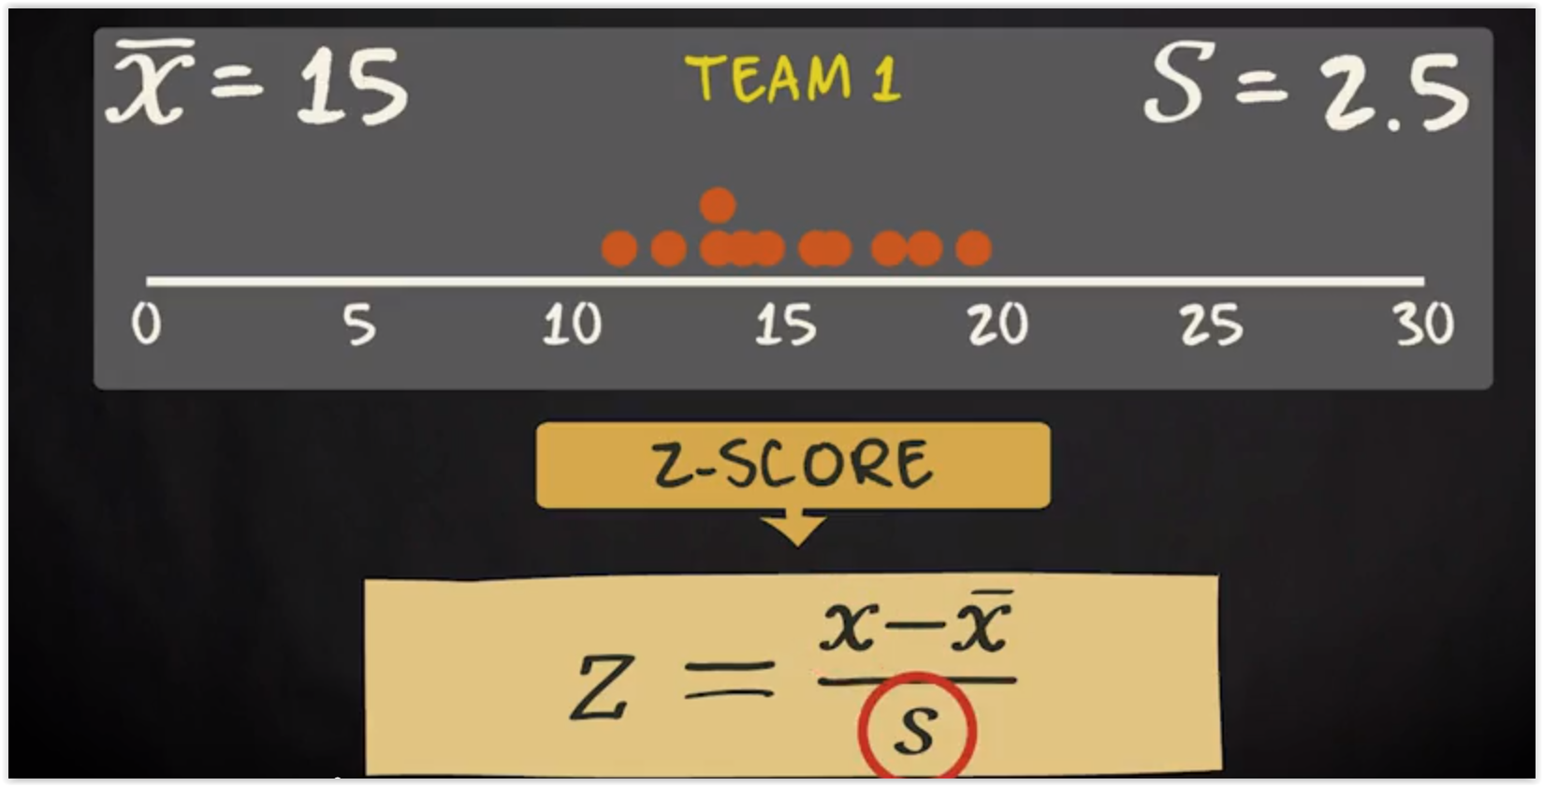
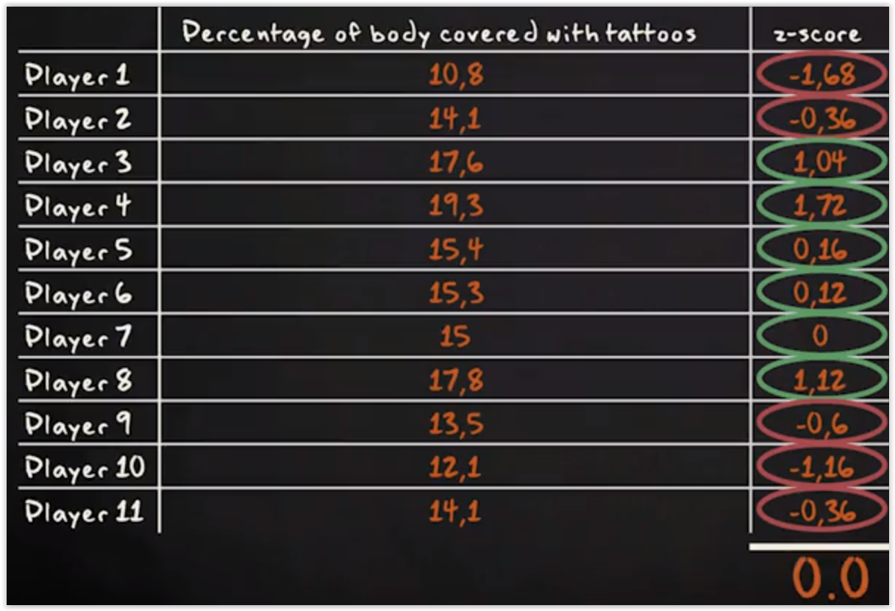
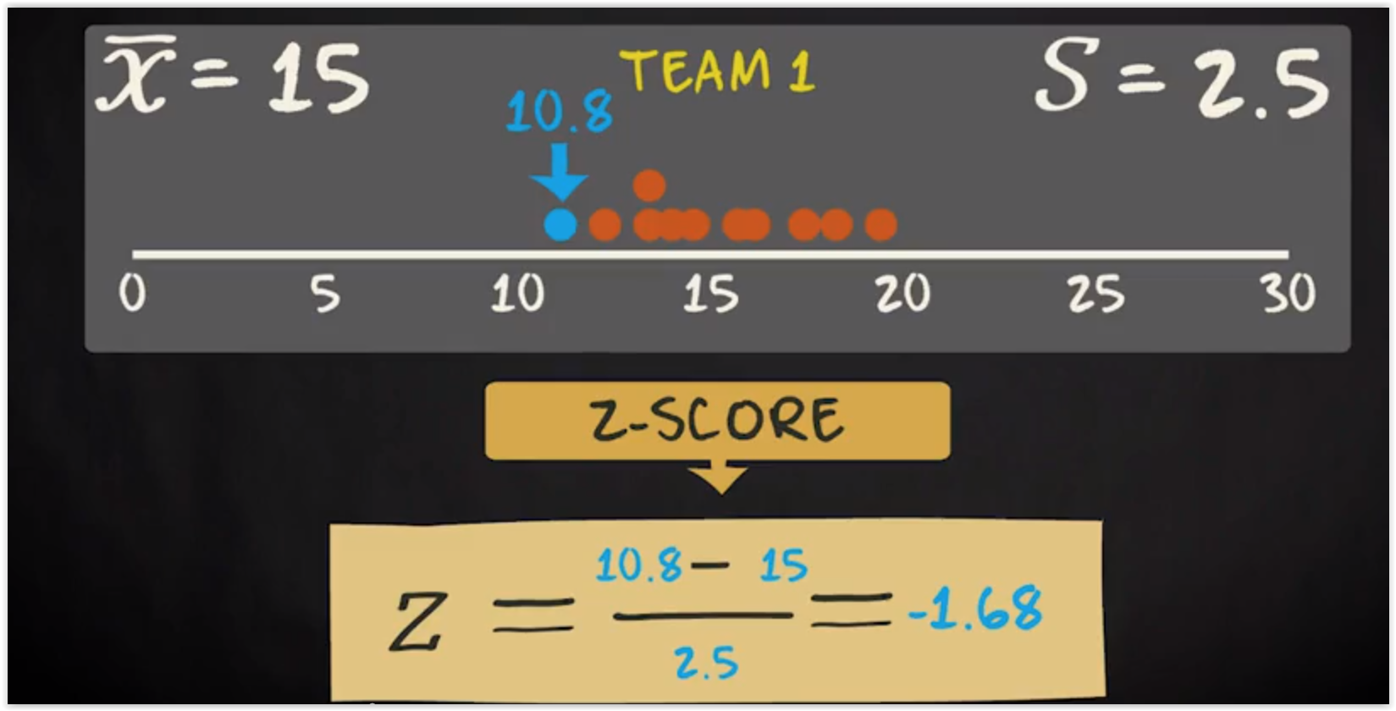
Z-scores
Negative z-scores represent values below the mean, and positive z-scores represent values above the mean.
Because the mean is the balance point of your distribution, the negative and positive z-scores cancel each other out. In other words, if you add up all z-scores, you will get a value of 0.

Slide 10
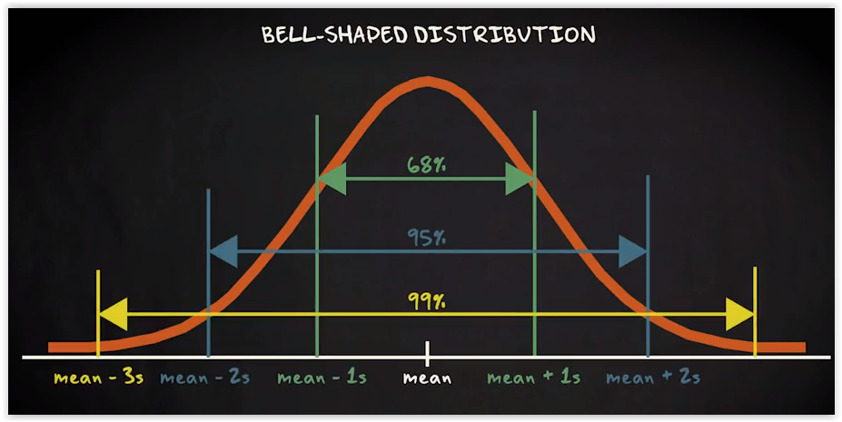
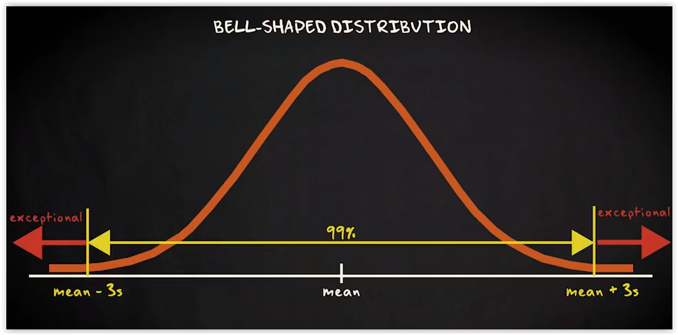
Z-scores
How do you know if a certain z-score is low or high?
A good rule is that if the histogram of your variable is bell shaped,
68% of the observations fall between z-scores -1 and 1.
95% between z-scores of -2 and 2, and
99% between z-scores of -3 and 3.
This means that for this type of distribution, a z-score of more than 3 or less than -3 can be conceived of as rather exceptional.

Slide 11
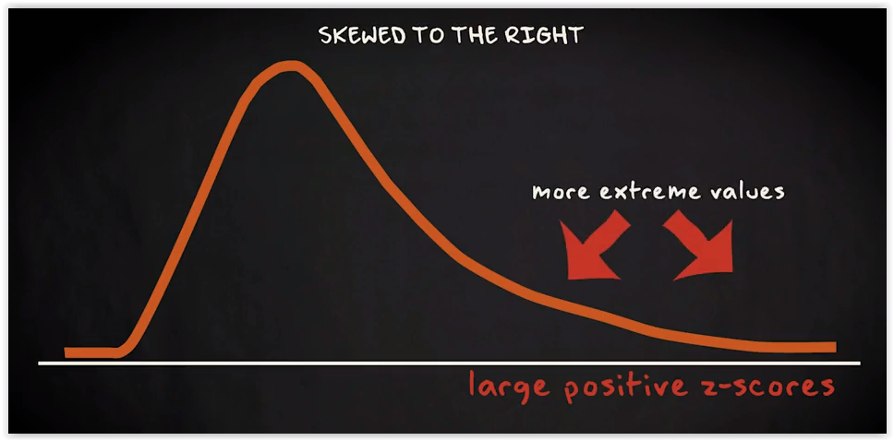
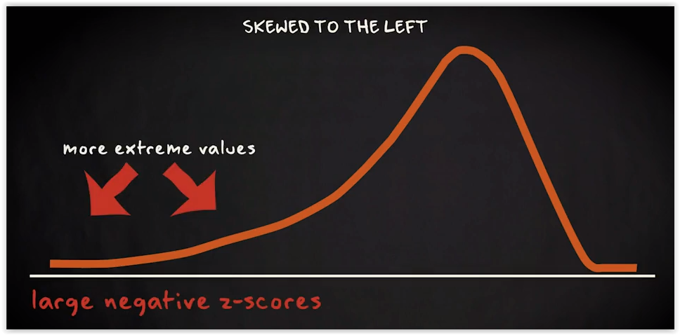
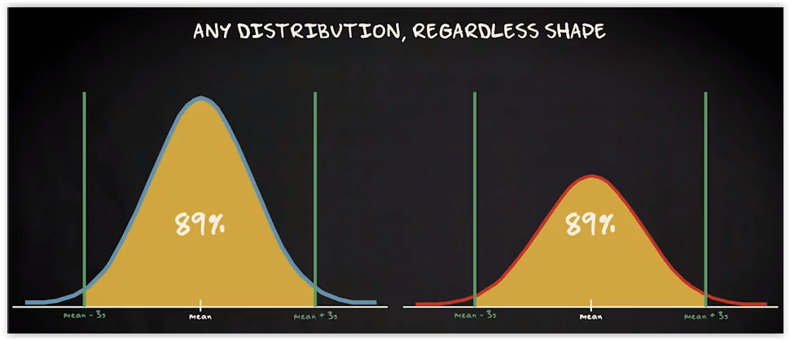
Z-scores
A rule that applies to any distribution regardless shape, is that 75% of the data must lie within a z-score of plus or minus 2.
And 89% within a z-score of plus or minus 3.

Slide 12
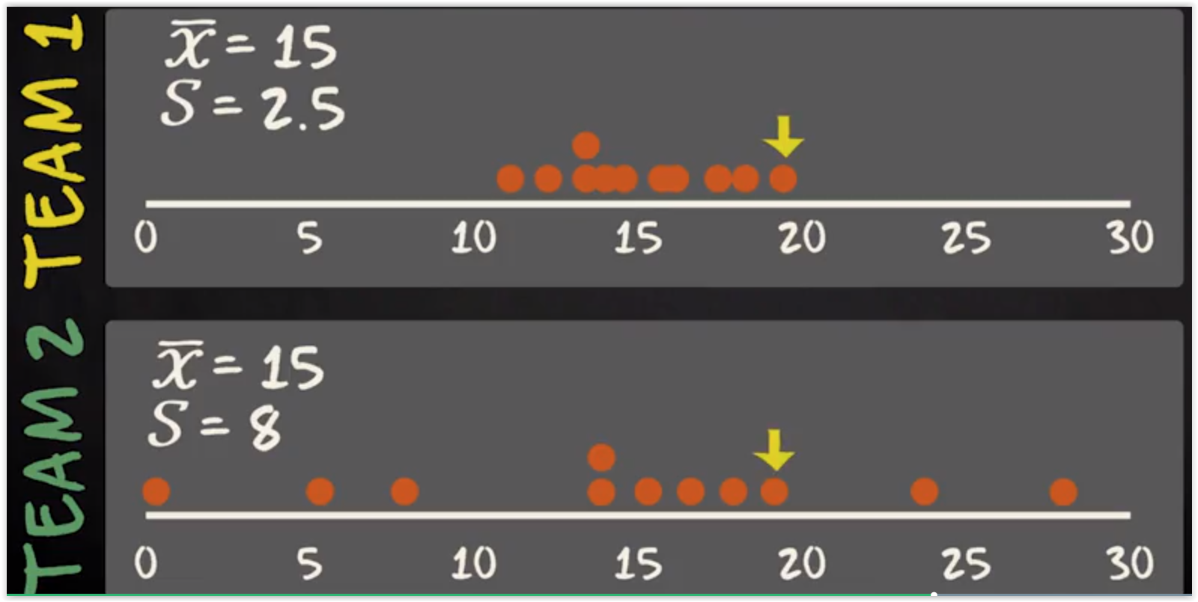
Question
Is the body weight 19.3 common or not?

Slide 13
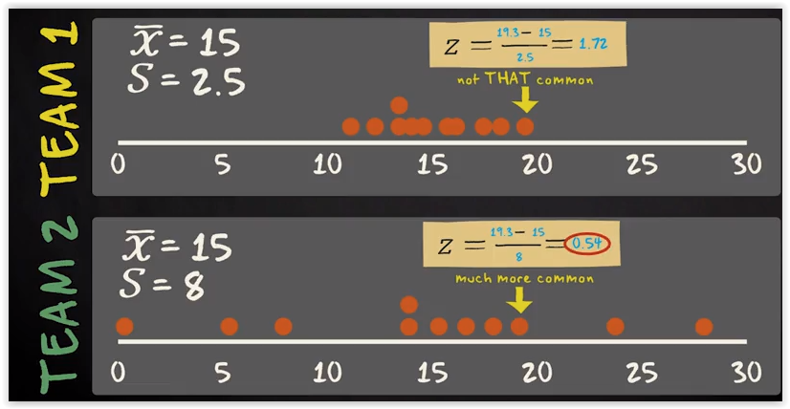
Answer
In team 1, the z-score is 1.72 standard deviations removed from the mean. In team 2, it is only 0.54 standard deviations removed from the mean.

Slide 14
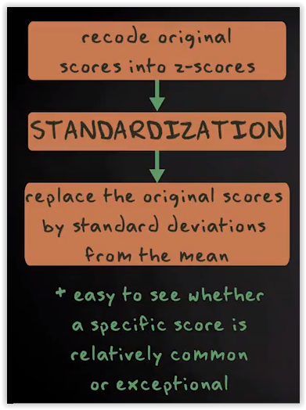
Standardization
If we recode original scores into z-scores, we say that we standardize a variable.
Standardization means that we replace the scores measured in the original metric by scores expressed in standard deviations from the mean.

Slide 15
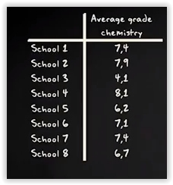
Exercise
Suppose you live in a city with eight high schools. You know high the average grade for chemistry for each high school. The lowest possible grade is a zero and the highest possible grade is a 10. The following is the data matrix:
What is the distribution of the variable average grade for chemistry?
What is the center of the distribution?
What is the variability of the distribution?
Make a box plot to visually represent center variability and outliers.
What the z-score of schools three tells you?

Slide 16
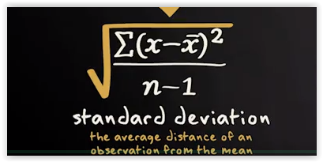
Hint

Slide 17
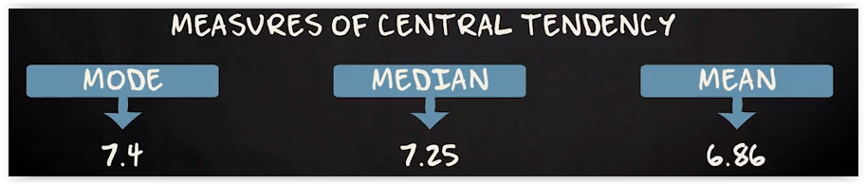
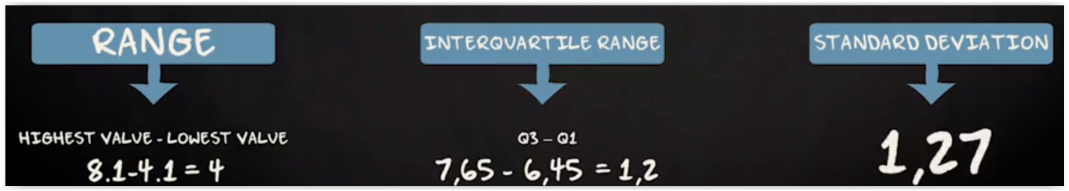
Answer

Slide 18
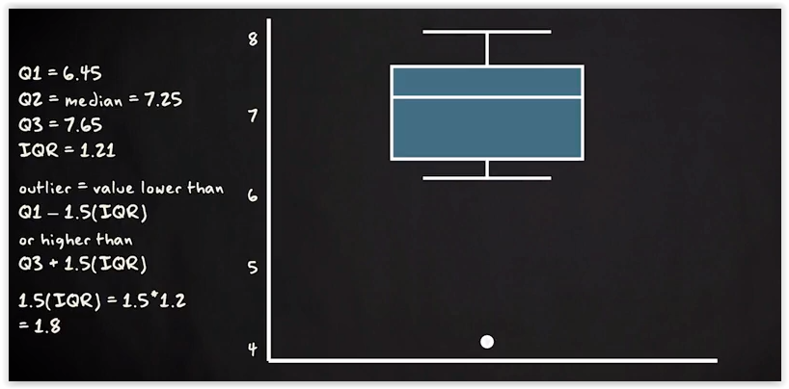
Answer

Slide 19
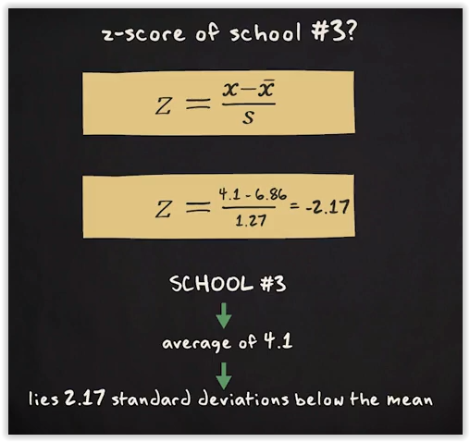
Answer

Slide 20
Statistical Inference
Statistical inference is the science of characterizing or making decisions about a population using information from a sample drawn from that population.
It is the act of passing from statistical sample data to generalizations (as of the value of population parameters) usually with calculated degrees of certainty.
Statistical inference frequently relies on making assumptions about the way data is distributed, or requires performing some transformation of the data to make it better fit some known distribution.

Slide 21
Hint
import numpy as np
a = np.array([7.4, 7.9, 4.1, 8.1, 6.2, 7.1, 7.4, 6.7])
from scipy import stats
stats.zscore(a)

